Slide 1
FAIR USE NOTICE
The material used in this presentation i.e., pictures/graphs/text, etc. is solely intended for educational/teaching purpose, offered free of cost to the students for use under special circumstances of Online Education due to COVID-19 Lockdown situation and may include copyrighted material - the use of which may not have been specifically authorised by Copyright Owners. Its application constitutes Fair Use of any such copyrighted material as provided in globally accepted law of many countries. The contents of presentations are intended only for the attendees of the class being conducted by the presenter.
Notes:
Enterprise Applications (EA) are a software solution that provide business logic and tools to model entire business processes for organisations to improve productivity and efficiency. Examples include billing systems, customer relationship management systems and supplier relationship management systems.

Slide 2
Propositional Logic

Slide 3
Contents
Example
Propositional Logic
Some Terms
Arguments
Inference Rules
Proofs
Entailment and Derivation

Slide 4
A simple software system example
Suppose, you want to develop a library information system which users can consult in order to find out about what books the library possesses, and also about their own use of the library -
who has a given book on loan, when it is due back, and so on.
The domain of the program consists of a number of different types of object: library items such as books, catalogue numbers assigned to these, locations where items are physically stored in the library, and individual borrowers, who may have various different statuses (e.g. in a university library, undergraduate, postgraduate, staff), their addresses, and so on.
There are innumerable constraints that must be satisfied, for example
A book cannot be on loan to more than one user at a time
Each copy of every book has a catalogue number that identifies it uniquely
Each borrower has a unique status which determines the normal period of loan for items borrowed,
Somehow the finished information system must behave in such a way that these constraints are all satisfied. How can the programmer make ensure that this is achieved? Of course the answer is by being systematic, and a very good way of being systematic is to express all the relevant constraints in logical form.
Thus, for example, the first constraint mentioned above might come out looking something like this:

Slide 5

CONTD.
The complete set of such constraints will constitute a formal specification of the information system, laying down criteria for what is to count as a correct implementation of the system.
There are several things that can be done with such a specification. Ideally, we would like to be able to do the following:
Use the specification to prove that the implementation is correct - i.e. that it does not violate any of the constraints.
Even better, by systematically transforming the specification, to produce a working program from it automatically, in such a way that the correct behaviour of the program is guaranteed.
By logical inference from the specification to determine what further properties any correct implementation of the specification must possess.

Slide 6
Propositional Logic
Prepositional logic is a formal system of representing knowledge
Prepositional logic has:
Syntax – what the allowable expressions are. Structure of the sentence.
Semantics – what the expressions mean. Meaning
Proof theory – how conclusions are drawn from a set of statements. Reasoning.
A proposition (p, q, r, …) is simply a statement (i.e., a declarative sentence) with a definite meaning, having a truth value that’s either true (T) or false (F) (never both, neither, or somewhere in between).
Examples
the reactor is on;
the wing-flaps are up;
John Major is prime minister.
whereas the following are not:
are you going out somewhere?
2+3

Slide 9
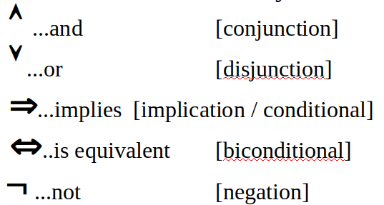
Propositional Logic
Logical constants: true, false
Propositional symbols: P, Q, S, ... (atomic sentences)
Wrapping parentheses: ( … )
Sentences are combined by connectives:
Literal: atomic sentence or negated atomic sentence

Slide 10
Propositional Logic
A simple language useful for showing key ideas and definitions
User defines a set of propositional symbols, like P and Q.
User defines the semantics of each propositional symbol:
P means “It is hot”
Q means “It is humid”
R means “It is raining”
A sentence (well-formed formula) is defined as follows:
A symbol is a sentence
If S is a sentence, then ¬S is a sentence
If S is a sentence, then (S) is a sentence
If S and T are sentences, then (S ^ T), (S v T), (S ⇒ T), and (S ↔ T) are sentences
A sentence results from a finite number of applications of the above rules

Slide 11
Some Terms
The meaning or semantics of a sentence determines its interpretation.
Given the truth values of all symbols in a sentence, it can be “evaluated” to determine its truth value (True or False).
A model for a KB is a “possible world” (assignment of truth values to propositional symbols) in which each sentence in the KB is True.
A valid sentence or tautology is a sentence that is True under all interpretations, no matter what the world is actually like or what the semantics is. Example: “It’s raining or it’s not raining.”
An inconsistent sentence or contradiction is a sentence that is False under all interpretations. The world is never like what it describes, as in “It’s raining and it’s not raining.”
P entails Q, written P |= Q, means that whenever P is True, so is Q. In other words, all models of P are also models of Q.

Slide 12

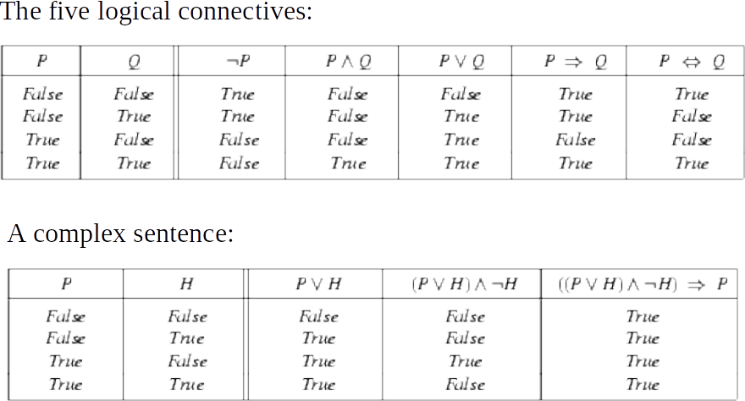



Truth Tables

Slide 13
Some Other Definitions
A literal is an atomic formula or the negation of an atomic formula.
A clause is a wff express a fact (premises or conclusion).
A clause set is a group of clauses express an argument.
A formula is in conjunctive normal form (CNF) if it is a conjunction of disjunction of literals.
A formula is in disjunctive normal form (DNF) if it is a disjunction of conjunction of literals.

Slide 14
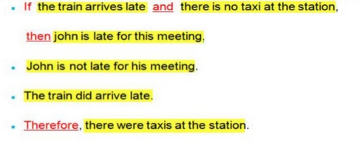
Propositional Logic - Arguments

Slide 15
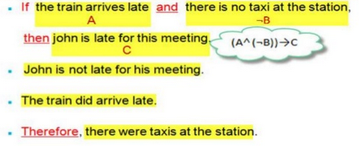
Propositional Logic - Arguments

Slide 16
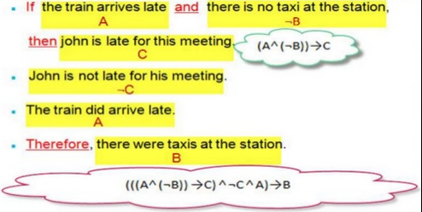
Propositional Logic - Arguments

Slide 17
CONTD.
An argument is a sequence of statements in which the conjunction of the initial statements (called the premises/hypotheses) is said to imply the final statement (called the conclusion).
An argument can be presented symbolically as (P1 Λ P2 Λ ... Λ Pn)-> Q where P1, P2, ..., Pn represent the hypotheses and Q represents the conclusion.
Deriving a logical conclusion by combining many propositions and using formal logic: hence, determining the truth of arguments.
This formula representing the whole argument as hypothesis and conclusion is known as NATURAL DEDUCTION

Slide 18
Inference Rules
Logical inference is used to create new sentences that logically follow from a given set of predicate calculus sentences (KB).
An inference rule is sound if every sentence X produced by an inference rule operating on a KB logically follows from the KB. (That is, the inference rule does not create any contradictions or you cannot prove anything that's wrong.)
An inference rule is complete if it is able to produce every expression that logically follows from (is entailed by) the KB. (means you can prove anything that's right)

Slide 19
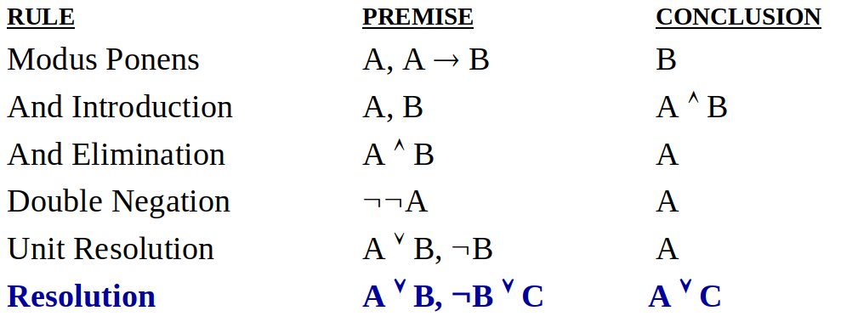
Inference Rules
Here are some examples of sound rules of inference
A rule is sound if its conclusion is true whenever the premise is true
Each can be shown to be sound using a truth table

Slide 20
Equivalence Rules
Name | Rule | Rule
Associativity | (P∧Q)∧R ⇔ P∧(Q∧R ) | (P∨Q)∨R ⇔ P∨(Q∨R)
Symmetry | (P∧Q) ⇔ (Q∧P) | (P∨Q) ⇔ (Q∨P)
Distributivity | P∧(Q∨R) ⇔ (P∧Q)∨(P∧R) | P∨(Q∧R) ⇔ (P∨Q)∧(P∨R)
Idempotency | P∧P ⇔ P | P∨P ⇔ P
DeMorgan's laws | ¬(P∧Q) ⇔ ¬P∨¬Q | ¬(P∨Q) ⇔ ¬P∧¬Q
Negation | P ⇔ ¬¬P | P⇒⊥ ⇔ ¬P
Horn Clause | P⇒Q ⇔ ¬P∨Q
Contraposition | P⇒Q ⇔ ¬Q⇒¬P

Slide 21
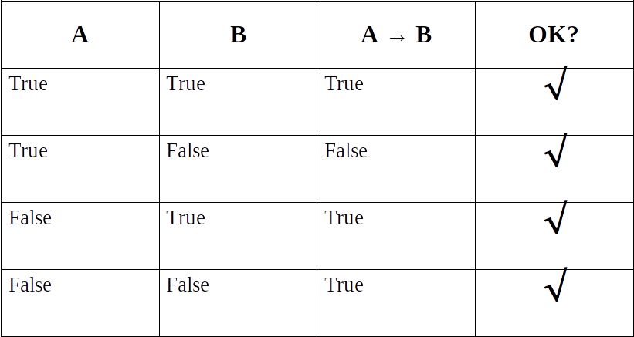
Soundness if Modes Ponens

Slide 22
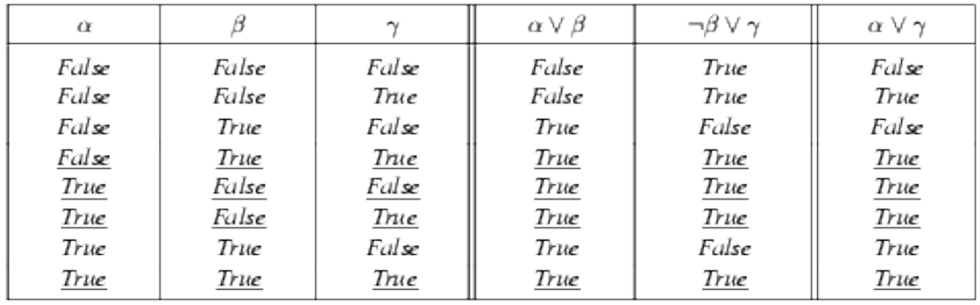
Soundness of Resolution Inference Rule
From the rightmost three columns of this truth table, we can see that (α v β )ʌ ( ┐β v γ ) → α v γ is valid regardless of the truth values assigned to α,β or γ

Slide 23
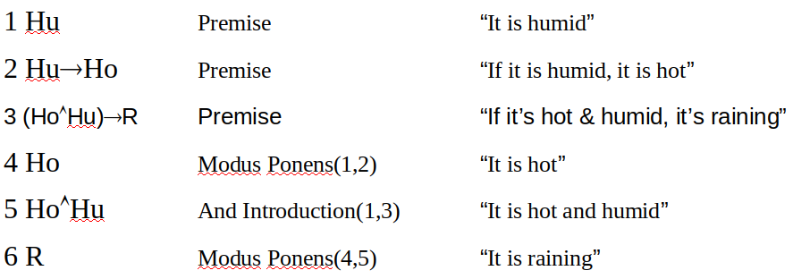
Proving Things
A proof is a sequence of sentences, where each sentence is either a premise or a sentence derived from earlier sentences in the proof by one of the rules of inference.
The last sentence is the theorem (also called goal or query) that we want to prove.
Example for the “weather problem” given above.

Slide 24
Task
Translate the following verbal argument to propositional logic argument and prove it to be valid.
Real Madrid is a superior power team, and either FC Barcelona is not strong or Juardiola makes an error. Juardiola does not make an error, but if FC Barcelona wins the game, then FC Barcelona is strong. Hence FC Barcelona loses the game and Real Madrid is a superior power team.

Slide 25
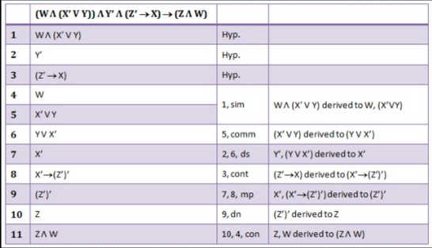
Solution
(W Λ (┐X V Y)) Λ ┐Y Λ (┐Z → X) → (Z Λ W)

